Slide 1
EUTF BENEFITS ADMINISTRATION SYSTEM UPDATE
This meeting will be recorded and saved to the HRO/Personnel Support Page:
https://eutfemployersonly.hawaii.gov/
Virtual Meeting with Employers
December 15, 2023

Slide 2
ARIEL BAS UPDATES
MAY 5, 2022
The EUTF went live on the new business Administration System (BAS)
One of the primary reasons for implementing the new BAS is the member self-service online portal (Member Portal).
The DOE, UH, the Judiciary, the City and County of Honolulu, the Honolulu Board of Water Supply, and the County of Maui. are uploading on a regular basis an electronic HR file containing new hires, terminations, internal transfers and demographic changes.
Hard copy EC-1 enrollment forms are not needed for new hire enrollment, address changes, BU changes, internal transfers and terminations.
The State Executive Branch, the Legislature, OHA, HHSC including all hospitals, and the County of Kauai also submit or are in the process of submitting an electronic HR file on a regular basis containing terminations, internal transfers and demographic changes.
Hard copy EC-1 enrollment forms are not needed for address changes, BU changes, transfers within executive branch and terminations.
New hires can be added via the employer portal and new hires can enroll online.

Slide 3
Next Phase
ARIEL BAS UPDATES
The next phase is expanding existing employee utilization of the Member Portal
Qualifying events (e.g. Marriage, Birth, Loss of Coverage, etc.)
Open enrollment (April 2024) EUTF will encourage employees to log into their account prior to April 2024 by highlighting the most popular medical/prescription drug plans and the free life insurance for employees to check their coverage. Phased approach to having members log on prior to open enrollment.

Slide 4
Launch Timeline
ARIEL BAS UPDATES
Employer | Target Launch Date
County of Maui County of Kauai (including Department of Water Supply) | 1/8/24
State Executive Branch OHA Judiciary Legislature HHSC | 1/29/24
DOE Charter Schools | 2/19/24
University of Hawaii | 3/4/24
City and County of Honolulu (including Board of Water Supply) County of Hawaii (including Department of Water Supply) | 3/18/24
Employers will be provided training materials and resources ahead of the launch date. EUTF will be available to provide support throughout this transition.

Slide 5
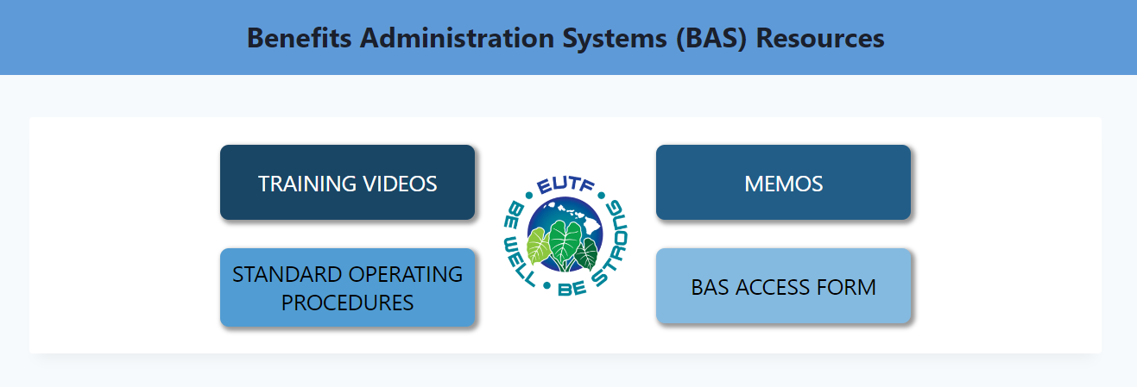
HRO/PERSONNEL WEBSITE
ARIEL BAS UPDATES
Please visit https://eutfemployersonly.hawaii.gov/ for the latest resources, forms, and memos.
Checkout memo dated 11/27 for details on current BAS usage.
Checkout the Standard Operating Procedures for details on navigating the Employer Portal.

Slide 6
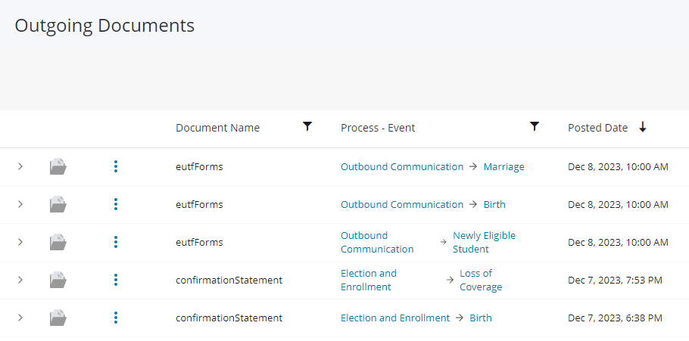
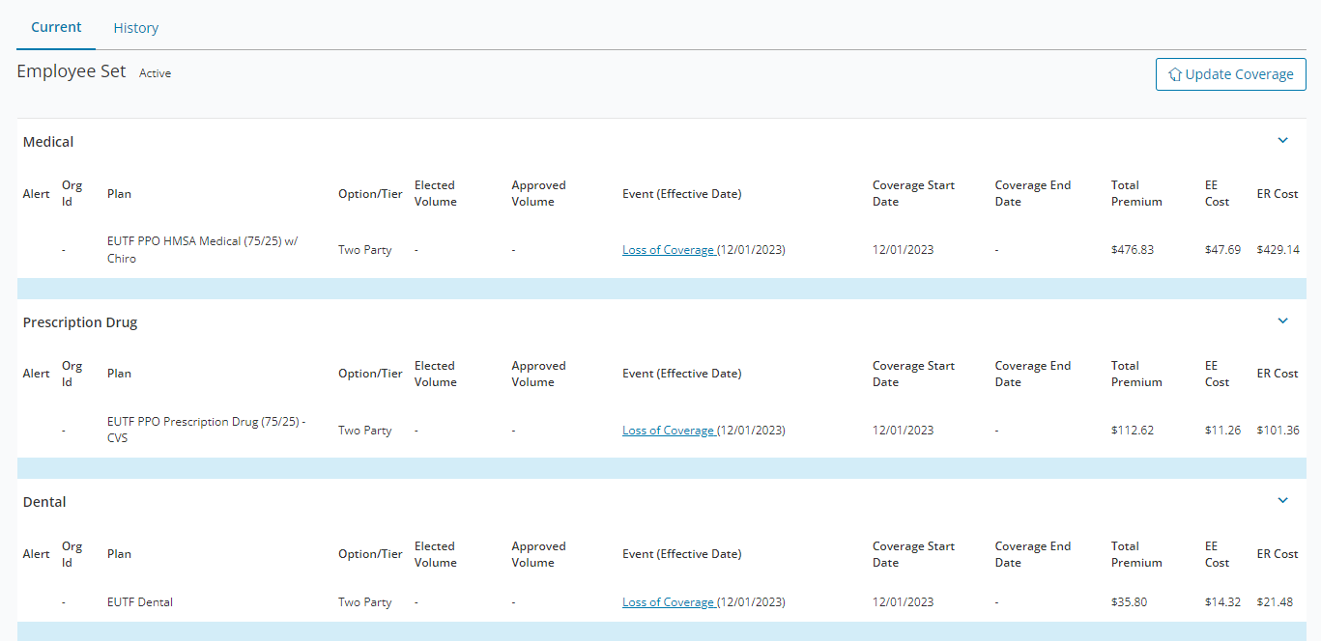
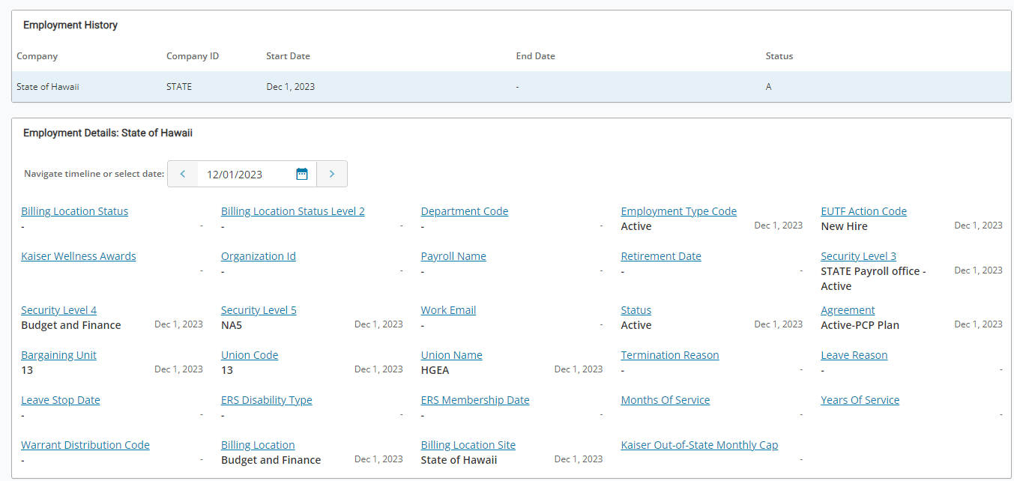
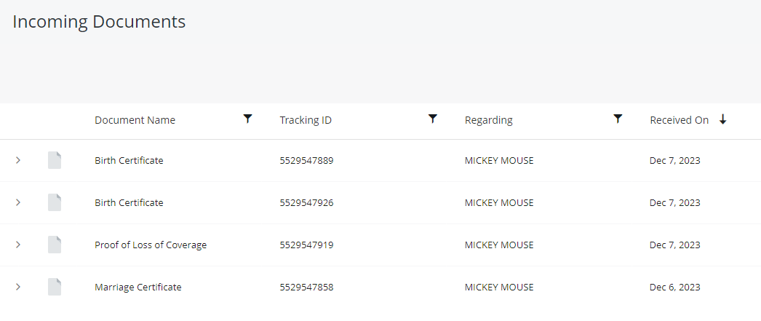
EMPLOYER PORTAL
ARIEL BAS UPDATES
Tips and Tricks
Access the Standard Operating Procedures located on the HRO/Personnel Website for detailed instructions on using the Employer Portal.
Confirm personal and demographic information by checking Participant Information.
Confirm employment history and Bargaining Unit by checking Employment Information.
Confirm current coverage by checking Coverage.
Confirm an event was processed by checking Enrollment History.
Confirm personal and demographic information by checking Participant Information.
Confirm that a form or document was received by the EUTF by checking Incoming Documents. Confirm that a document was sent (e.g. confirmation notice, COBRA form) by checking Outgoing Documents.
Please contact eutfemployer@hawaii.gov if you need assistance specifically with the Employer Portal, including access requests.

Slide 7
How Employers Can Reach Us
Phone
(808)586-7390
Email
eutf@hawaii.gov
General questions relating to enrollment, eligibility, etc., select option 2
Accounting-related questions, select option 3
Avoid peak hours (11-2, Mondays/day following holiday).
Normal response time is 1-2 business days.
Forms cannot be submitted via email.
Questions specific to access or issues with the employer portal: eutfemployer@hawaii.gov
Questions specific to access or issues with Axway: dbf.eutf.servicedesk@hawaii.gov

Slide 8
Thank you
Questions? ​
Contact Jessica McDonald, Member Services Branch Manager
Phone: (808)547-2334
Email: Jessica.s.mcdonald@Hawaii.gov

Slide 9
Appendix - Enrollment Trends
Active Enrollment – Medical & Drug (EUTF)
Medical, Chiro and Rx | 7/16 | 7/17 | 7/18 | 7/19 | 7/20 | 7/21 | 11/22 | 7/23 | 7/23 Counts | 7/1/16 Self EE Monthly | 7/1/17 Self EE Monthly | 7/1/23 Self EE Monthly
EUTF Plans
H - HMO | 5% | 3% | 3% | 2% | 2% | 2% | 2% | 1% | 706 | $387 | $443 | $510
H - 90/10 | 13 | 10 | 9 | 8 | 7 | 6 | 6 | 5 | 2,492 | 312 | 345 | 508
K - Comp | 14 | 13 | 12 | 11 | 10 | 10 | 9 | 9 | 4,038 | 211 | 247 | 353
H - 80/20 | 49 | 36 | 33 | 29 | 27 | 26 | 24 | 23 | 10,987 | 215 | 234 | 302
K – Stan. | 12 | 14 | 15 | 17 | 18 | 18 | 19 | 19 | 9,014 | 66 | 59 | 50
H - 75/25 | 5 | 22 | 27 | 31 | 34 | 37 | 39 | 41 | 19,272 | 142 | 54 | 49
Supp. | 2 | 2 | 2 | 2 | 2 | 1 | 1 | 1 | 587 | 17 | 17 | 14
Total EE | 45,586 | 45,540 | 46,902 | 47,737 | 48,374 | 47,776 | 47,569 | 47,096
Change | 1.1% | -0.1% | 3.0% | 1.8% | 1.3% | -0.1% | -0.4% | -1.0%
Notes:
$

Slide 10
Appendix - Enrollment Trends
Active Enrollment – Medical & Drug (HSTA VB and Totals)
Medical, Chiro, Vision and Rx | 7/16 | 7/17 | 7/18 | 7/19 | 7/20 | 7/21 | 11/22 | 7/23 | 11/22 Counts | 7/1/21 Self EE Monthly | 7/1/23 Self EE Monthly
HSTA VB Plans
H - 90/10 | 29% | 28% | 27% | 26% | 26% | 26% | 26% | 25% | 966 | $357 | $393
K - Comp | 18 | 19 | 20 | 20 | 20 | 20 | 20 | 20 | 756 | 252 | 284
H - 80/20 | 53 | 53 | 54 | 54 | 54 | 54 | 54 | 55 | 2,011 | 252 | 278
Total EE | 6,258 | 5,251 | 4,822 | 4,409 | 4,117 | 3,733 | 3,357 | 3,186
Change | -6.8% | -16.1% | -8.2% | -8.6% | -6.6% | -9.3% | -10.1% | -5.1%
All Plans
Total EE | 51,844 | 50,791 | 51,274 | 52,146 | 52,491 | 51,509 | 50,926 | 50,282
Change | 0.05% | -2.0% | 1.8% | 0.8% | 0.7% | -1.9% | -1.1% | -1.3%

Slide 11
Appendix- HMSA Medical/Prescription Drug Plans
In-network benefit | HMO | 90/10 PPO | 80/20 PPO | 75/25 PPO
Calendar year maximum out-of-pocket (MOOP) (Single/Family) | $1,500/$3,000 (Rx $4,350/$8,700) | $2,000/$4,000 (Rx $4,350/$8,700) | $2,500/$5,000 (Rx $4,350/$8,700) | $5,000/$10,000 (Rx $3,150/$6,300)
Deductible (Single/Family) | None | None | None | $300/$900
Employee (EE) Share of Costs
Inpatient services | No charge | 10% | 20% | 25%
Outpatient services (e.g., physician visits, DXL, surgery) | No charge or $15 | 10% | 20% | 25%
Emergency room | $100 | 10% | 20% | 25%
Prescription Drug Benefits | Copayments/coinsurance and prescription drugs covered are the same. Only difference is the MOOP noted above.
# of EEs Enrolled at 12/1/23 | 723 | 2,526 | 11,035 | 19,766
%age of Total EEs Enrolled at 12/1/23 | 2% | 5% | 23% | 41%
EE’s Monthly Share of Premiums 7/1/23
Self | $509.94 | $507.50 | $302.24 | $48.56
Two-Party | 1,238.98 | 1,232.92 | 734.10 | 117.90
Family | 1,580.00 | 1,572.20 | 935.88 | 150.28

Slide 12
Appendix- Kaiser Permanente Medical/Prescription Drug Plans
In-network benefit | Comprehensive | Standard
Calendar year maximum out-of-pocket including prescription drugs (MOOP) (Single/Family) | $2,000/$6,000 | $2,500/$7,500
Deductible (Single/Family) | None | None
Employee (EE) Share of Costs
Inpatient services | No charge | 15%
Outpatient services (e.g., physician visits, DXL, surgery) | $15 | $20, 15% or 20%
Emergency room | $50 | $100
Prescription Drug Benefits | See Employee Health Benefits Reference Guide for details. In general, the Comprehensive plan has lower copayments than the Standard plan.
# of EEs Enrolled at 12/1/23 | 4,073 | 9,276
%age of Total EEs Enrolled at 12/1/23 | 8% | 19%
EE’s Monthly Share of Premiums 7/1/23
Self | $352.54 | $50.00
Two-Party | 857.22 | 121.50
Family | 1,094.48 | 155.00

